Slide 1
Network Addressing
CNA 426/526
Computer Networking II
Dr. Tirthankar Ghosh
CNA St. Cloud State University

Slide 2
What are IP Addresses?
32-bit address.
Denoted by dotted decimal or binary format.
Example:
01010101.00001111.11110000.00000011
85.15.240.3
CNA St. Cloud State University

Slide 3
Classes of IP Address
Class A : 8 bits for network, 24 bits for host (starting bit 0), denoted by /8.
Class B : 16 bits for network, 16 bits for host (starting bits 10), denoted by /16.
Class C : 24 bits for network, 8 bits for host (starting bits 110), denoted by /24.
Class D : Multicast address (starting bits 1110)
Class E : Reserved for future use (starting bits 11110)
CNA St. Cloud State University

Slide 4
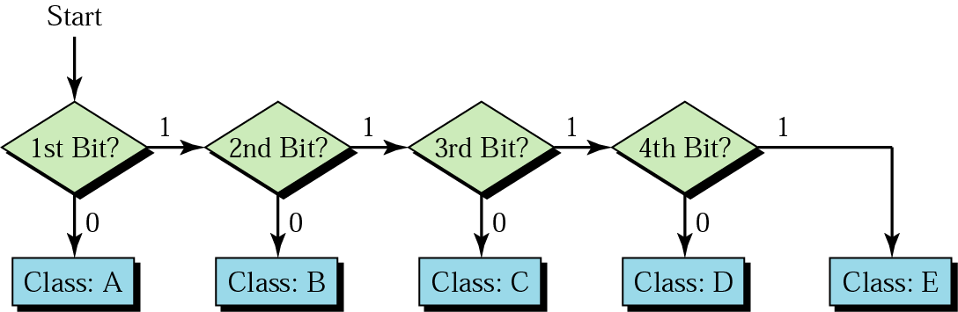
Finding Address Class
CNA St. Cloud State University

Slide 5
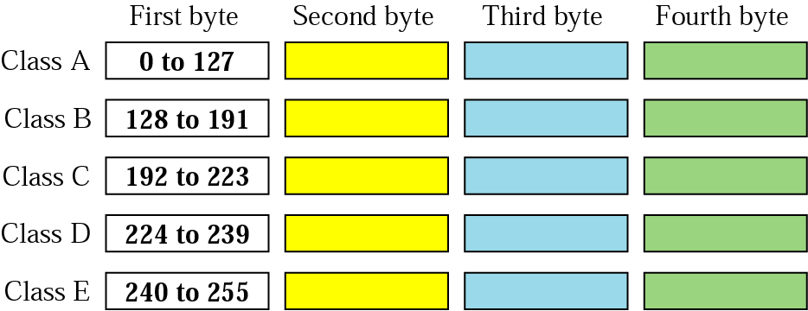
Finding the Class in Decimal Notation
CNA St. Cloud State University

Slide 6
Example
Find the class of each address:
a. 227.12.14.87
b. 252.5.15.111
c. 134.11.78.56
Solution
a. The first byte is 227 (between 224 and 239); the class is D.
b. The first byte is 252 (between 240 and 255); the class is E.
c. The first byte is 134 (between 128 and 191); the class is B.
CNA St. Cloud State University

Slide 7

Example
Find the error, if any, in the following IPv4 addresses.
Solution
a. There must be no leading zero (045).
b. There can be no more than four numbers.
c. Each number needs to be less than or equal to 255.
d. A mixture of binary notation and dotted-decimal
notation is not allowed.
CNA St. Cloud State University

Slide 8
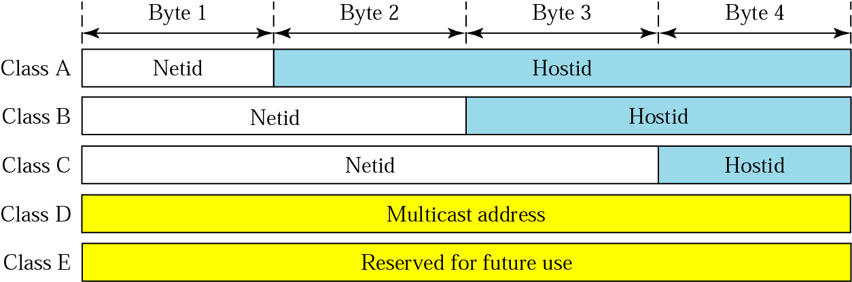
NetID and HostID
CNA St. Cloud State University

Slide 9
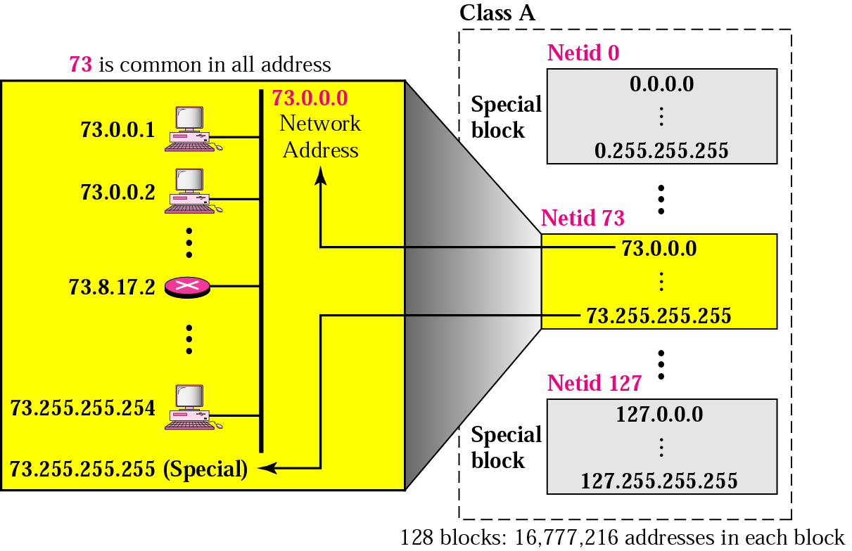
Blocks in Class A
CNA St. Cloud State University

Slide 10
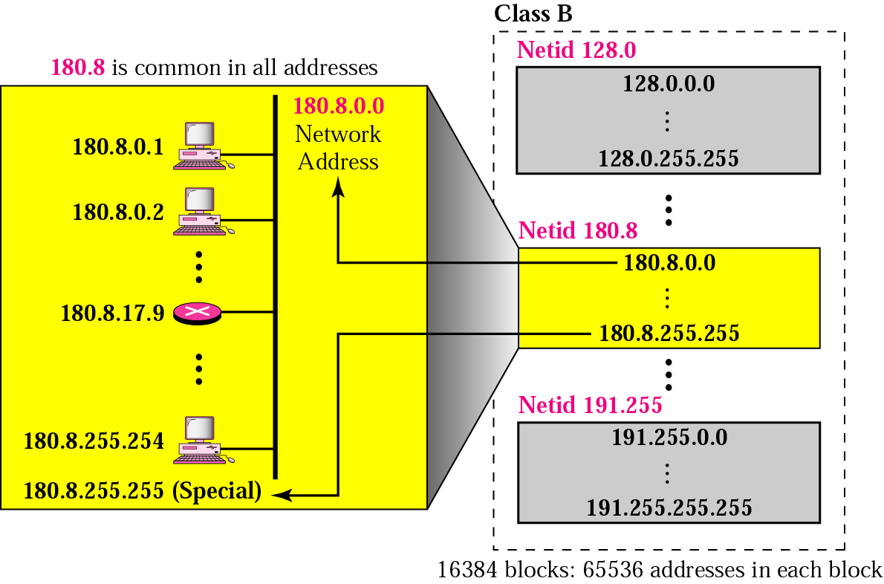
Blocks in Class B
CNA St. Cloud State University

Slide 11
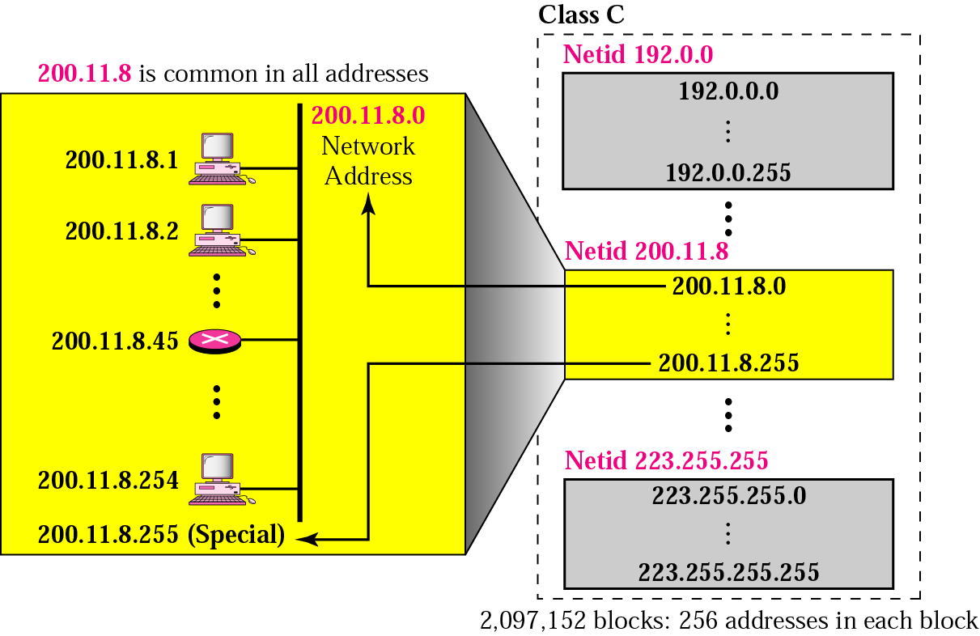
Blocks in Class C
CNA St. Cloud State University

Slide 12
Some Facts
Millions of class A addresses are wasted.
Many class B addresses are wasted.
The number of addresses in class C is smaller than the needs of most organizations.
CNA St. Cloud State University

Slide 13
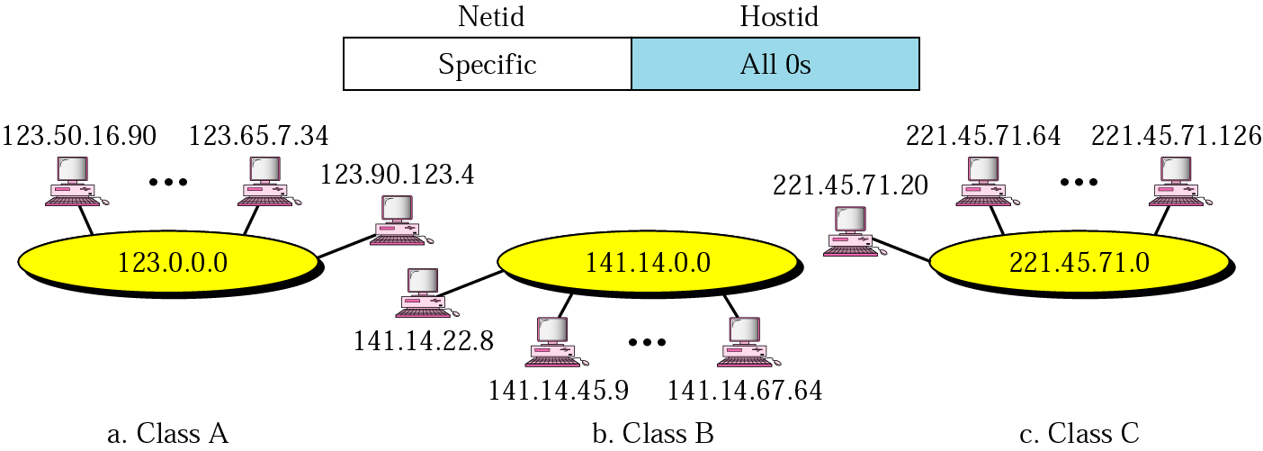
Concept of Network Address
CNA St. Cloud State University

Slide 14
Concept of Mask
Default Mask:
Class | In Binary | In Dotted-Decimal | Using Slash
A | 11111111 00000000 00000000 00000000 | 255.0.0.0 | /8
B | 11111111 11111111 00000000 00000000 | 255.255.0.0 | /16
C | 11111111 111111111 11111111 00000000 | 255.255.255.0 | /24
CNA St. Cloud State University

Slide 15
Example
A router outside the organization receives a packet with destination address 190.240.7.91. Show how it finds the network address to route the packet.
Solution
The router follows three steps:
The router looks at the first byte of the address to find the class. It is class B.
The default mask for class B is 255.255.0.0. The router ANDs this mask with the address to get 190.240.0.0.
The router looks in its routing table to find out how to route the packet to this destination. Later, we will see what happens if this destination does not exist.
CNA St. Cloud State University

Slide 16
Subnetting
In subnetting, a network is divided into several smaller groups (subnets), each subnet has its own subnetwork address.
CNA St. Cloud State University

Slide 17
Subnetting Example
An organization is given a network address of 131.94.0.0/16.
The organization wants to create 6 subnets.
It borrows three bits (2³ = 8) from the host part.
Its new subnet address will start from 131.94.32.0/19 (as 3 bits will be borrowed from the host part and added to the network part).
CNA St. Cloud State University

Slide 18
Classless IP Addresses (VLSM)
Why is it needed?
  To accommodate more networks and hosts
  To have flexibility in design
Why is it flexible?
/24
/28
CNA St. Cloud State University

Slide 19
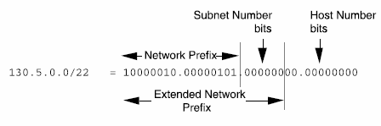
VLSM Example
130.5.0.0/16 with a /22 Extended Network Prefix
Ref. 3Com Corporation
CNA St. Cloud State University

Slide 20
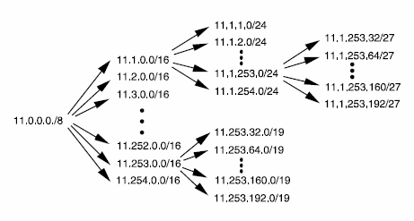
VLSM Example (cont’d)
Recursive Division of a Network Prefix
Ref. 3Com Corporation
CNA St. Cloud State University

Slide 21
Example
A block of addresses is granted to a small organization. We know that one of the addresses is 205.16.37.39/28. What is the first address in the block?
Solution
The binary representation of the given address is
11001101 00010000 00100101 00100111
If we set 32−28 rightmost bits to 0, we get
11001101 00010000 00100101 0010000 0
or
205.16.37.32.
CNA St. Cloud State University

Slide 22
Example
Find the last address for the block.
Solution
The binary representation of the given address is
11001101 00010000 00100101 00100111
If we set 32 − 28 rightmost bits to 1, we get
11001101 00010000 00100101 00101111
or
205.16.37.47
CNA St. Cloud State University

Slide 23
Example
Find the number of addresses in the last example.
Solution
The value of n is 28, which means that number
of addresses is 2 ³²⁻²⁸ or 16.
CNA St. Cloud State University

Slide 24
Forwarding Algorithm by Longest Match
Route with longer extended network prefix describes a smaller set of destinations.
Hence, a route with longer extended network prefix is more specific.
Routers must use the route with longest extended network prefix.
CNA St. Cloud State University

Slide 25
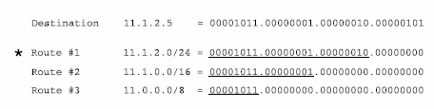
Longest Match (cont’d)
Ref. 3Com Corporation
CNA St. Cloud State University

Slide 26
Route Summarization
Method by which contiguous networks can be grouped together and advertised as one large network.
Supernetting – division is moved to the left.
To reduce the size of the route table.
Example:
172.16.1.0/24
172.16.2.0/24 172.16.1.0/22
172.16.3.0/24
CNA St. Cloud State University

Slide 27
Route Summarization (cont’d)
Route summarization can only be done when the IP addresses are contiguous.
Can we do summarization in the following cases?
  10.1.3.0/24, 10.1.4.0/24, 10.1.5.0/24
  10.1.10.0/24, 10.1.33.0/24, 10.1.50.0/24
CNA St. Cloud State University

Slide 28

Private Addressing
Used in a network that doesn’t need to be reached by the outside world.
IANA (Internet Assigned Numbers Authority) allocated three blocks of IP addresses:
CNA St. Cloud State University

Slide 29
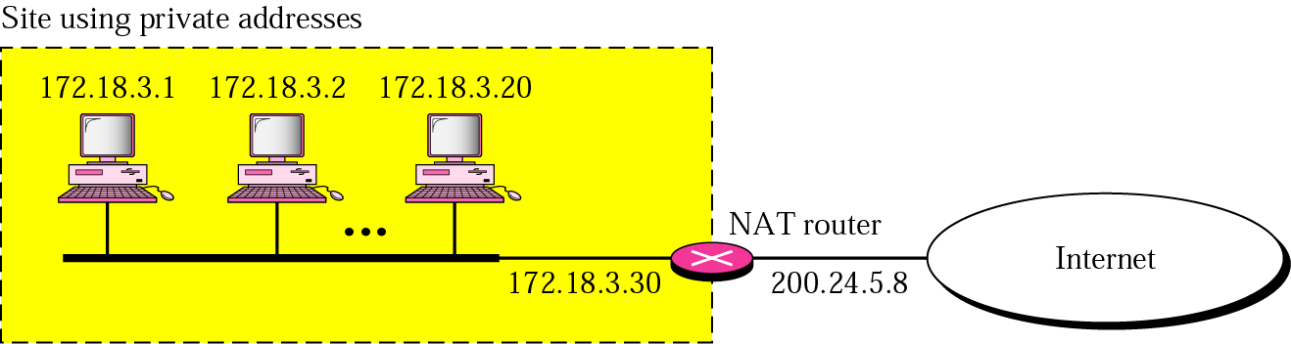
Network Address Translation (NAT)
CNA St. Cloud State University

Slide 30
NAT (cont’d)
An access list is created to delimit which private addresses will be allowed to be assigned registered IP addresses (from NAT pool).
NAT outside interface – maps a private IP to a registered IP.
NAT inside interface – maps a registered IP to a private IP.
CNA St. Cloud State University

Slide 31
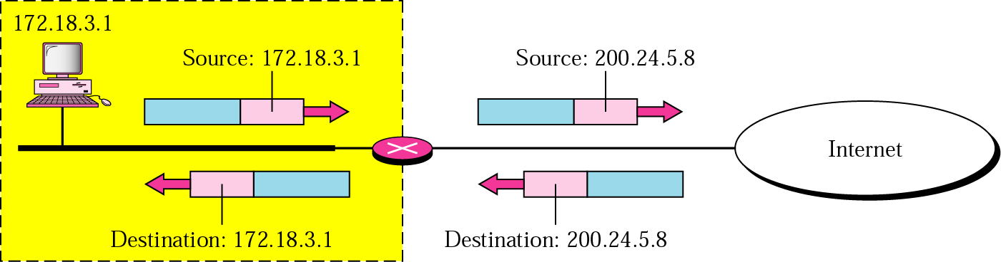
Address Translation
CNA St. Cloud State University

Slide 32
Address Translation (cont’d)
For incoming packets, how will the router know which private address the packets are destined for?
CNA St. Cloud State University

Slide 33
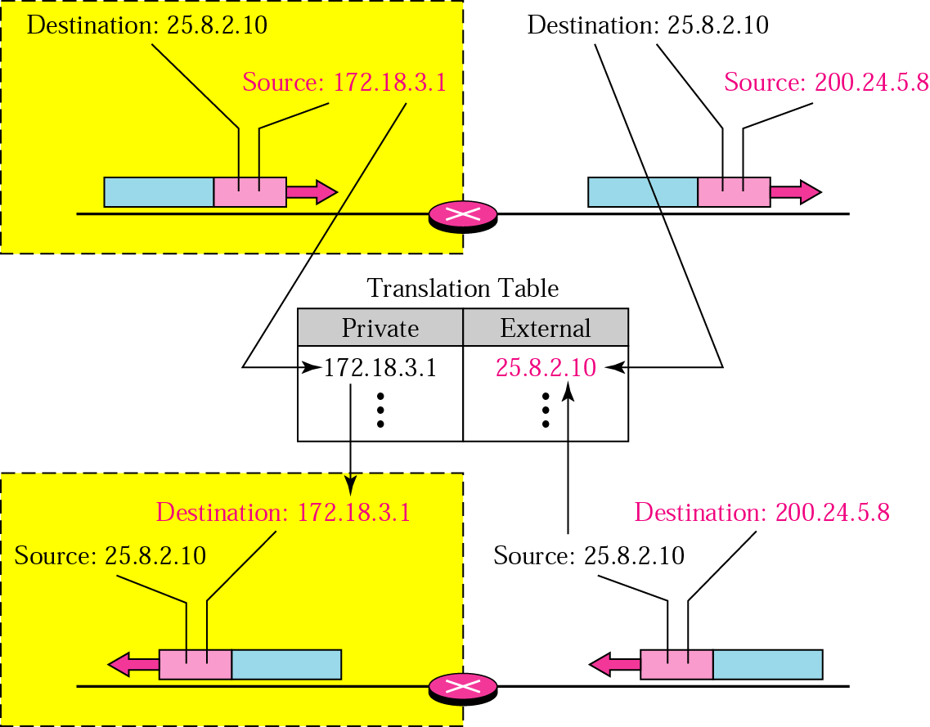
Address Translation (cont’d)
CNA St. Cloud State University

Slide 34
NAT (cont’d)
Pool of IP addresses used to allow more than one hosts to access the outside network.
Use both IP addresses and Port numbers.
CNA St. Cloud State University

Slide 35
Translation Table
Private Address | Private Port | External Address | External Port | Transport Protocol
172.18.3.1 | 1400 | 25.8.3.2 | 80 | TCP
172.18.3.2 | 1401 | 25.8.3.2 | 80 | TCP
... | ... | ... | ... | ...
CNA St. Cloud State University

